Slide 1

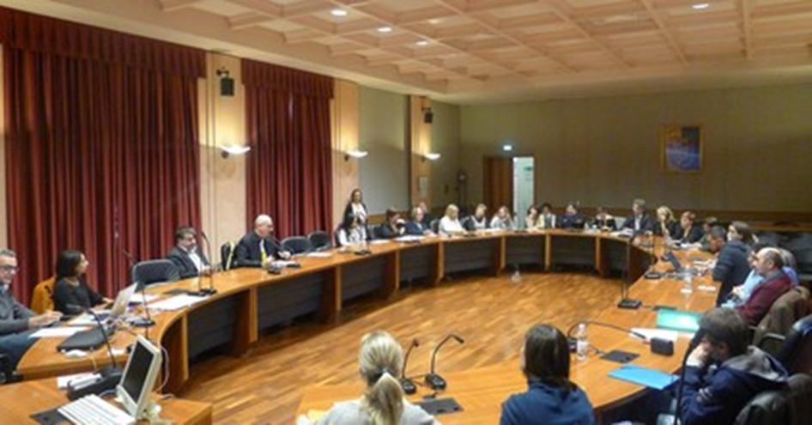
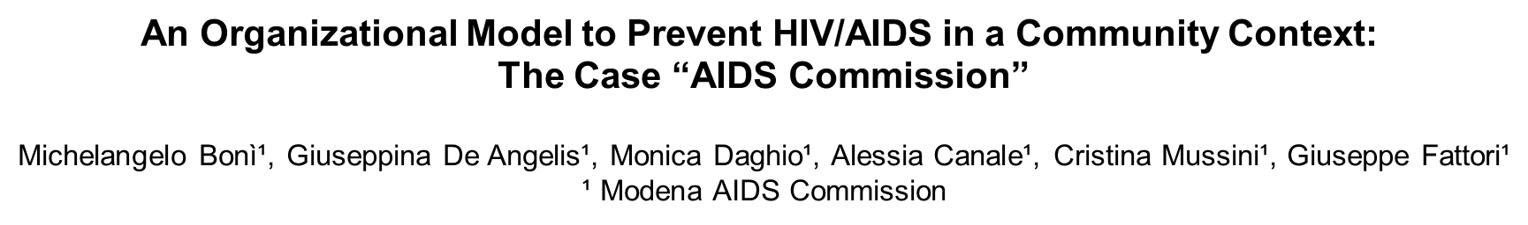

Modena AIDS Commission

Slide 2

Introduction
Literature
In literature we can find many cases where a proper organizational model is the basis of the fight against the spread of AIDS. Recent studies talk of setting policy and promoting the development of organizational models for the prevention of AIDS designed by a community and for that specific community context.
Focus
Therefore the focus is shifted toward an organizational and community model.
Focus
An Organizational Model to Prevent HIV/AIDS in a Community Context: The Case “AIDS Commission”

Slide 3
Purpose / Methods
To outline a conceptual and organizational model for culturally appropriate AIDS prevention capacity building in the territory of Modena.
To present the experiences gained from a 7 year program carried out between Local Health Unit professionals and the local Community.
The organizational model adopted with the AIDS Commission of Emilia-Romagna has led to the creation of the Modena AIDS Commission.
At the base of the project there is a partnership among subjects from different areas (Politicians, Health Professionals, Volunteers, Pharmacies etc.) This method ensures an interdisciplinary approach with the sharing of visions, goals and policies.
An Organizational Model to Prevent HIV/AIDS in a Community Context: The Case “AIDS Commission”

Slide 4
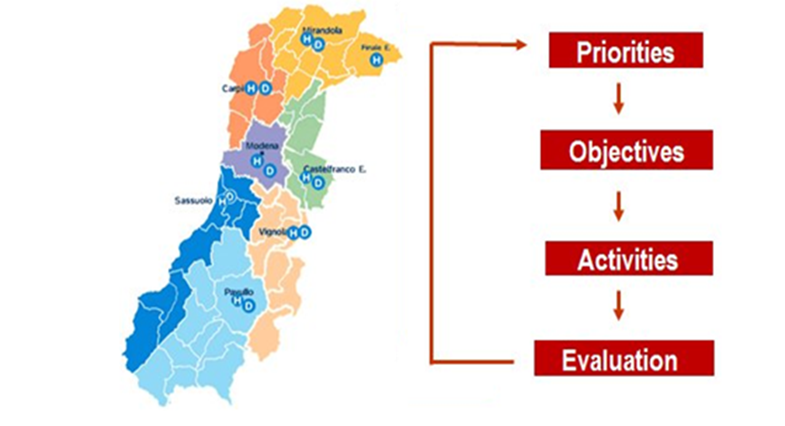
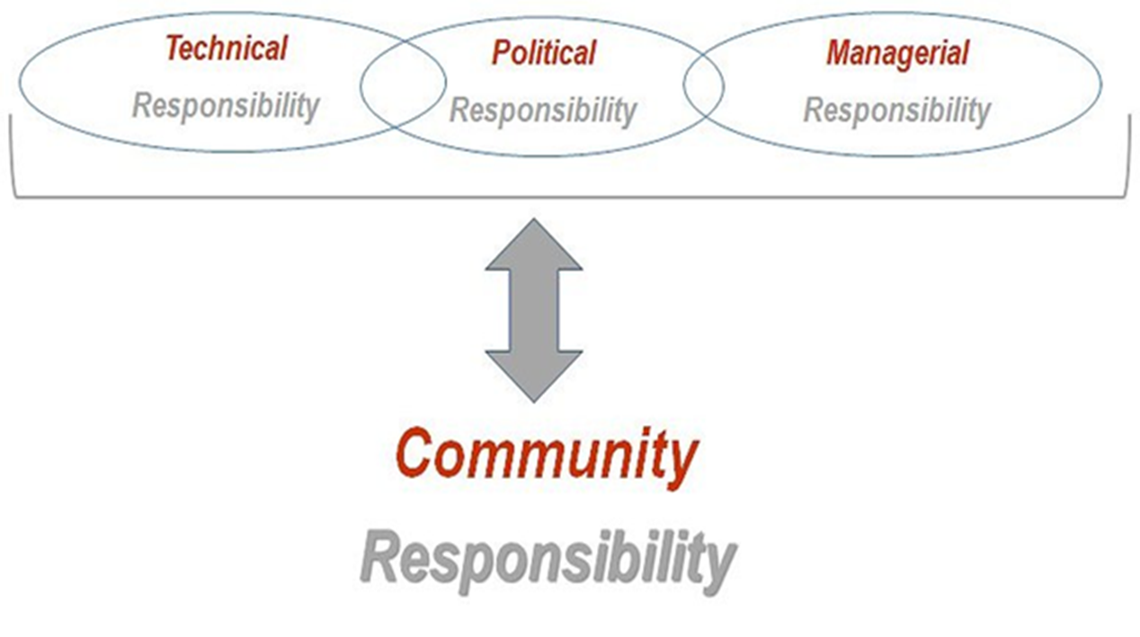
The organizational model
The path starts from the definition of objectives and activities and ends with the evaluation of the outcomes.
The model has 3 levels of responsibility: political, technical and managerial. The technical coordination which acts on the basis of strategic decisions made by the PA Manager and Health Professionals ensures the performance of the Commission’s activities.
An Organizational Model to Prevent HIV/AIDS in a Community Context: The Case “AIDS Commission”

Slide 5
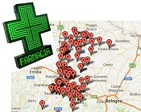

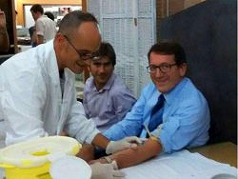






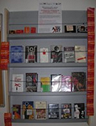
Activities from 2008
Maps
Creation of interactive Google Maps for the identification of condom vending machines.
Test Days
Seven “Test Days” were organized with the Municipality of Modena
Training
Training sessions were held for health professionals and pharmacists with the University of Modena.
Libraries
Collaboration with the Network of Libraries of the province of Modena that provides spaces dedicated to the documentation with the availability of HIV/AIDS information materials.
Awareness Campaigns
Online and offline Awareness Campaigns.
App
Mobile App "Helpaids".
An Organizational Model to Prevent HIV/AIDS in a Community Context: The Case “AIDS Commission”

Slide 6
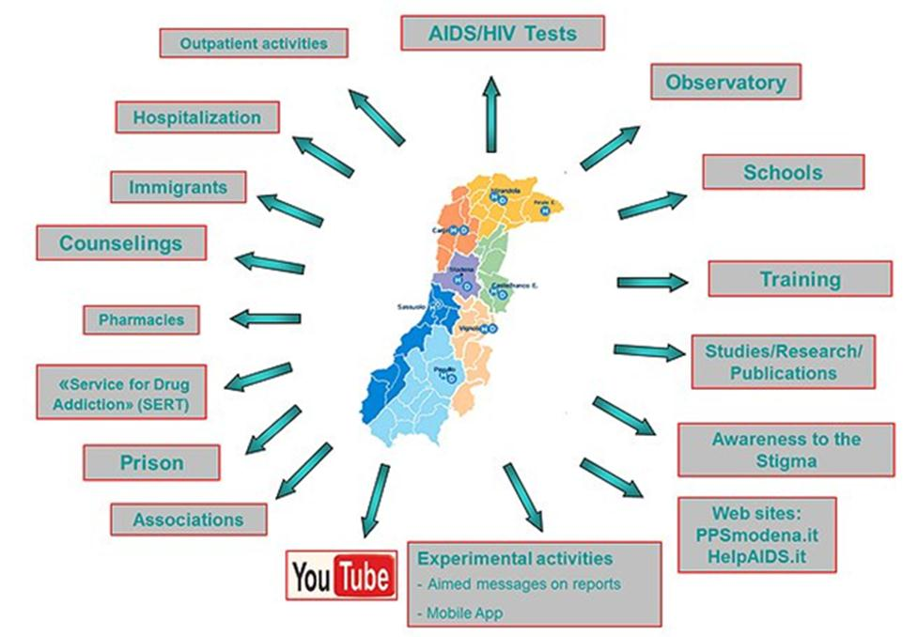
Conclusion
Although the path towards a full institutionalization of the AIDS Commission in the Community of Modena is still far off. This organizational model also allows the simplification of decision-making processes that would otherwise be difficult to implement.
A significant resource savings (in terms of costs and time) and a higher level of performance
“The organizational model proposed here, is particularly suitable to be adopted in the context of Public Health”
An Organizational Model to Prevent HIV/AIDS in a Community Context: The Case “AIDS Commission”

Slide 7
Thanks!
Any questions?
You can find us at:
www.ppsmodena.it/commissioneaids
pps@ausl.mo.it
An Organizational Model to Prevent HIV/AIDS in a Community Context: The Case “AIDS Commission”

